Slide 1
Cocaine self-administration and silent synapses
Matthew A. Weber
April 8th, 2016

Slide 2
Primary Article: Ma et al., 2014
Bi-directional modulation of incubation of cocaine craving by silent synapse-based remodeling of prefrontal cortex to accumbens projections
Background #1: Koya et al., 2012
Silent synapses in selectively activated nucleus accumbens neurons following cocaine sensitization
Background #2: Lee et al., 2013
Maturation of silent synapses in amygdala-accumbens projection contributes to incubation of cocaine craving

Slide 3
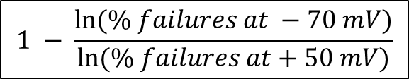
Keep in Mind
Silent synapses: “immature glutamatergic synapses containing stable NMDA receptors, while AMPA receptors are either absent or highly labile (Ma et al., 2014)”
How do you estimate the number of silent synapses?
  “Silent synapses can be detected by measuring evoked EPSCs at -80 [-70] mV, where AMPARs, but not NMDARs, are activated, and at +40 [+50], where NMDARs contribute strongly to EPSCs (Koya et al., 2012)”
  Silent synapses should have a higher failure rate at -80 [-70] mV than at +40 [+50] mV
Incubation of cocaine craving: “progressive increase in cue-induced cocaine seeking after withdrawal from the drug (Ma et al., 2014)”
$$1 − \frac{ln⁡(\% failures at −70 mV)}{ln⁡(\% failures at+50 mV)}$$

Slide 4
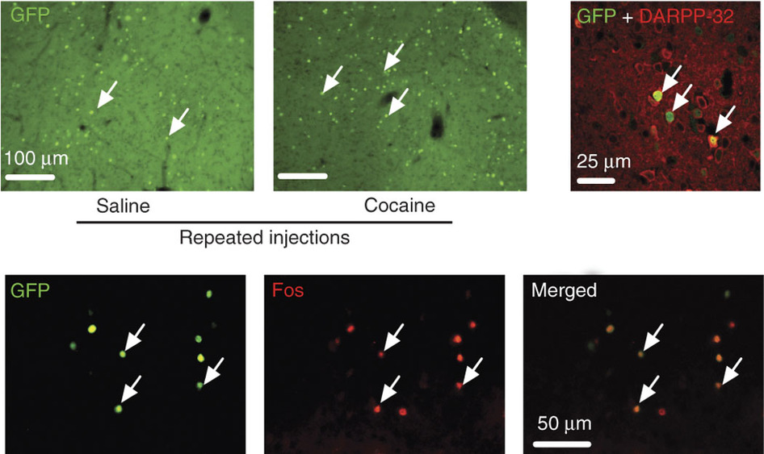
Koya et al., 2012: Figure 1
Repeated cocaine administration activates neurons in the nucleus accumbens

Slide 5
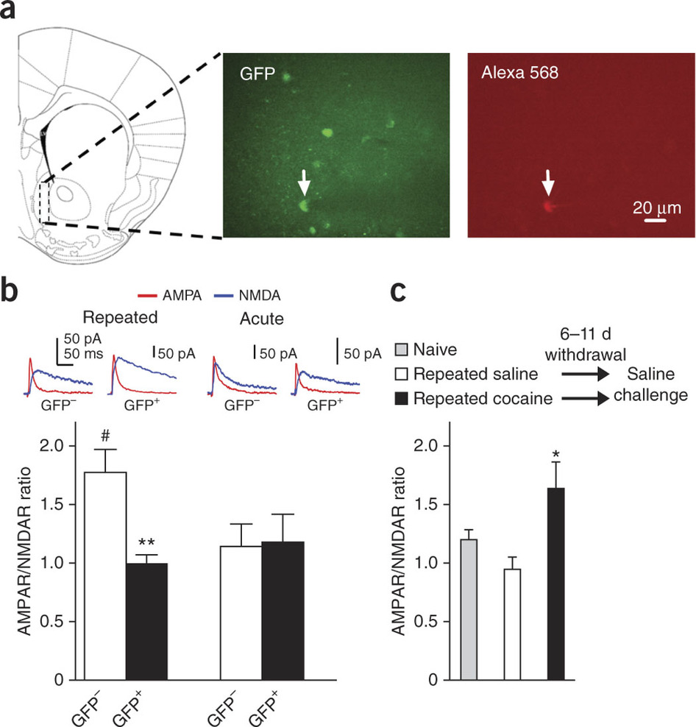
Koya et al., 2012: Figure 2
Repeated cocaine administration decreased the glutamatergic synaptic strength of activated neurons

Slide 6
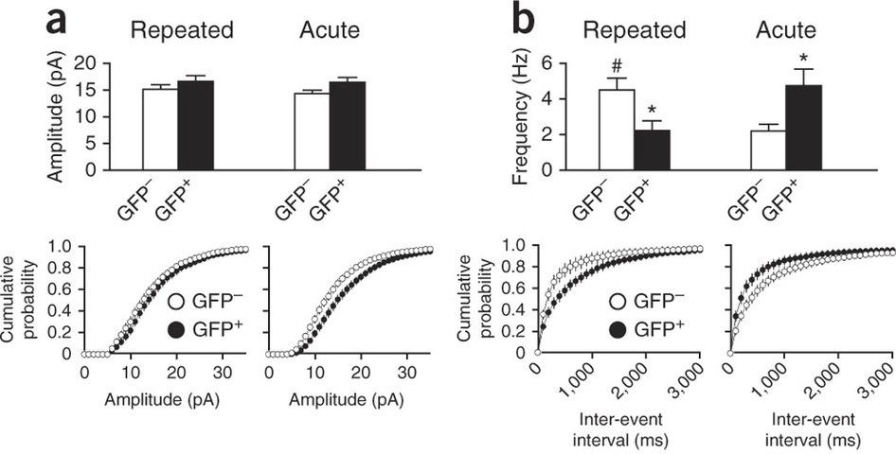
Koya et al., 2012: Figure 5
Repeated cocaine administration increases the frequency but not the amplitude of sEPSCs in activated neurons

Slide 7
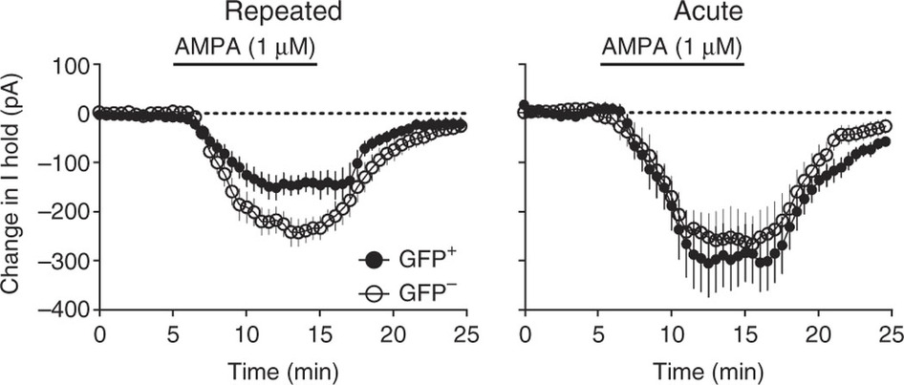
Koya et al., 2012: Figure 4
Repeated cocaine administration decreases the inward current of activated neurons

Slide 8
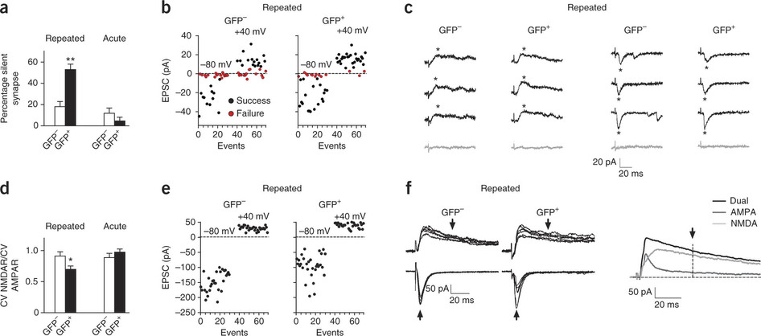
Koya et al., 2012: Figure 6
Repeated cocaine administration increases the number of silent synapses in activated neurons

Slide 9
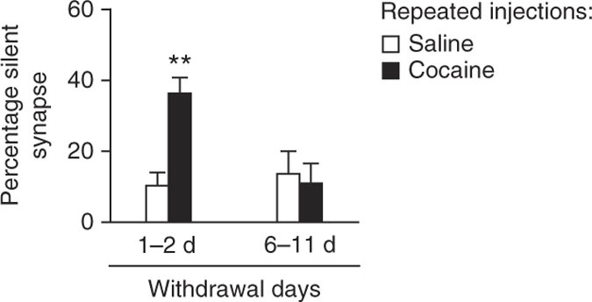
Koya et al., 2012: Figure 7
Repeated cocaine administration increases the number of silent synapses after 1-2 days withdrawal but not 6-11 days withdrawal

Slide 10
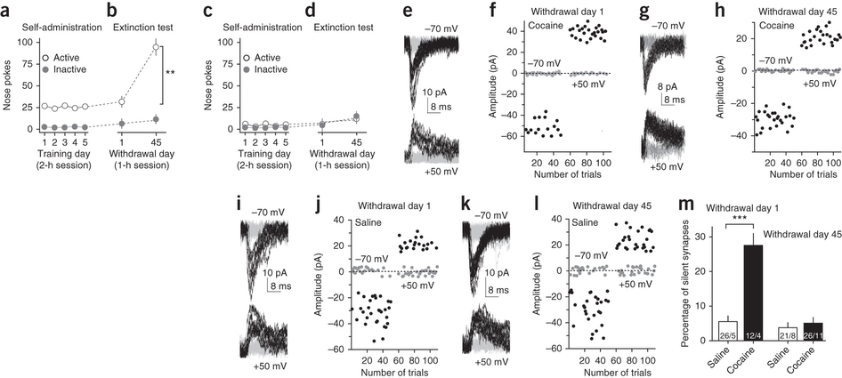
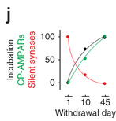
Lee et al., 2013: Figure 2
Cocaine self-administration increases cocaine craving and increases the number of silent synapses after 1 day withdrawal, but not after 45 days withdrawal

Slide 11
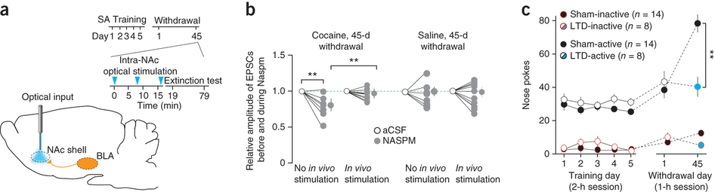
Lee et al., 2013: Figure 7
Optical LTD reverses incubation of cocaine craving (likely through internalizing CP-AMPARs)

Slide 12
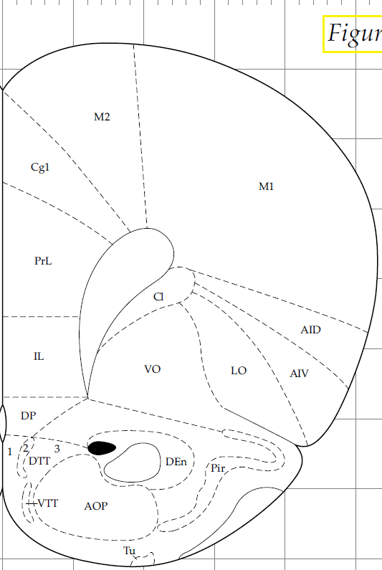
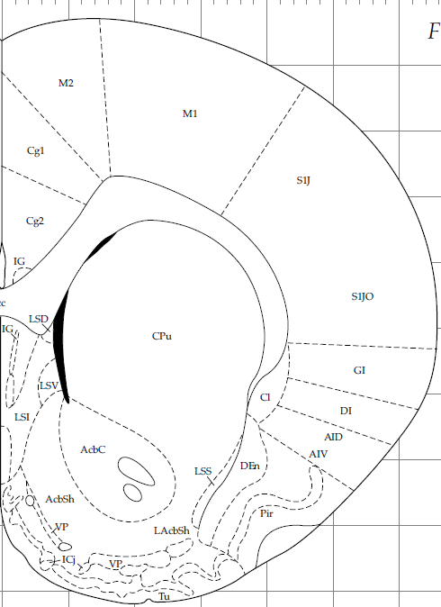
Keep in Mind
Glutamatergic projections from mPFC to NAc

Slide 13
Keep in Mind
Naspm: Calcium permeable (CP) AMPA (CP-AMPA) receptor antagonist
NBQX: AMPA receptor antagonist
APV: NMDA receptor antagonist
LY: metabotropic glutamate receptor (mGluR1) antagonist

Slide 14
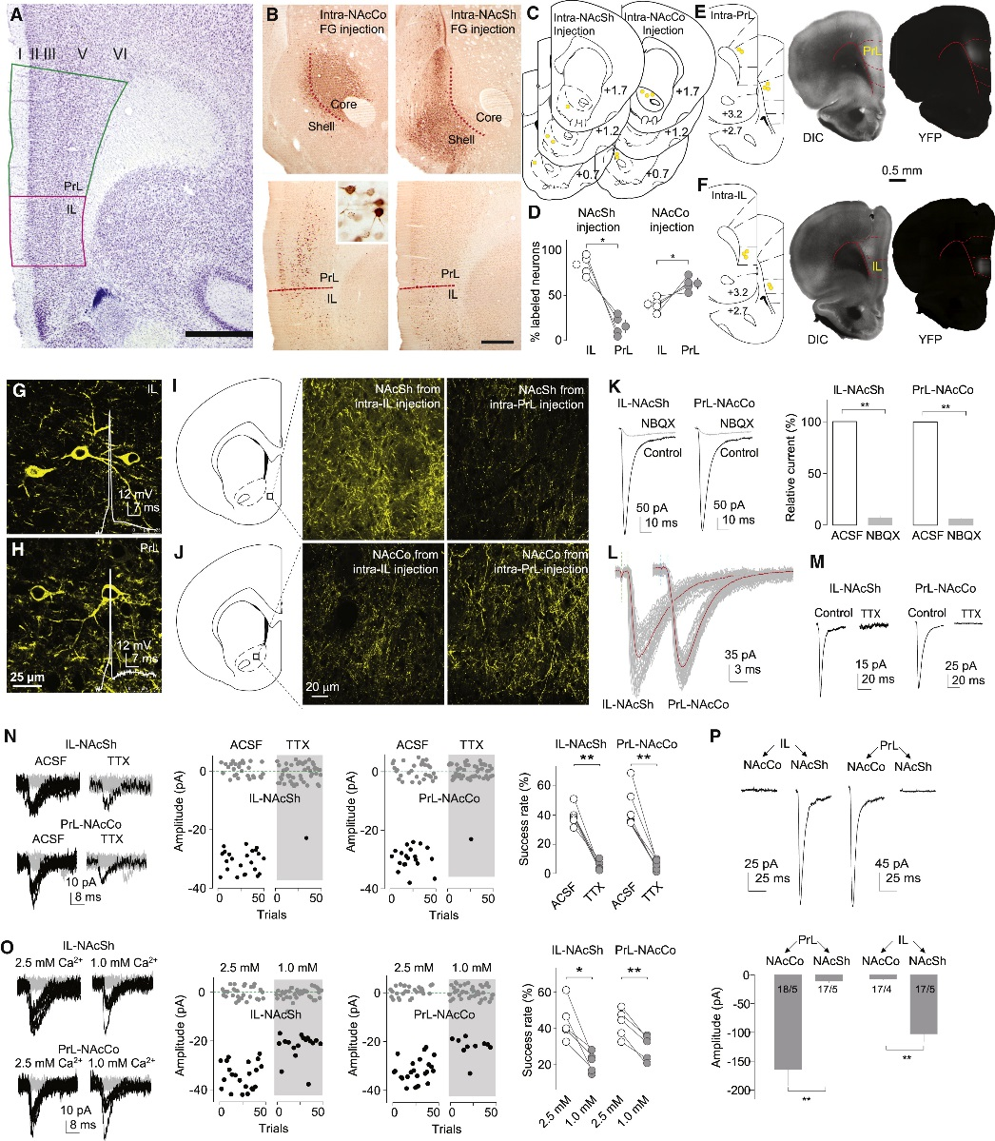
Ma et al., 2014: Figure 1
Anatomical and Electrophysiological Differentiation of the IL-to-NAcSh and PrL-to-NAcCo Projections in Rats
Notes:
(A) A coronal section stained for Nissl showing the cytoarchitectonic boundaries of the IL and PrL in the rat, including the relatively indistinct lamina in the IL (but not the PrL) and the sudden change from a compacted to a scattered layer II at the PrL-IL border. Scale bar, 1 mm.
(B) Representative images showing immunoperoxidase labeling for FG at the injection sites involving mainly the NAcCo or NAcSh and the corresponding distribution of retrogradely labeled cells in the PrL and IL. Inset shows FG-labeled neurons at 40× magnification. Scale bar, 500 μm; 50 μm for insert.
(C) Diagrams of coronal slices showing the injection sites (yellow dots) of FG in the NAcCo of five rats (left) and ventral-medial NAcSh of four rats (right).
(D) Summarized results showing that intra-NAcSh injections of FG resulted in a higher percentage of labeled neurons in IL (83.1% ± 5.9%) than PrL (16.9% ± 5.9%; t3 = 5.65, p = 0.01), and that intra-NAcCo injection of FG resulted in a higher percentage of neurons labeled in PrL (61.7% ± 3.2%) than IL (38.3% ± 3.2%; t4 = 3.60, p = 0.02).

Slide 15
Ma et al., 2014: Figure 1
Anatomical and Electrophysiological Differentiation of the IL-to-NAcSh and PrL-to-NAcCo Projections in Rats
Notes:
(E) Diagrams of coronal slices showing the injection sites (yellow dots) where ChR2-expressing AAV2 was injected in the PrL of five anesthetized rats (left), and light (DIC, middle) and fluorescent (YFP, right) images showing the expression site of ChR2 3 weeks after intra-PrL injection of ChR2-AAV2.
(F) Same experimental setup as shown in (E) for intra-IL injection of ChR2.
(G and H) Confocal images showing ChR2-expressing IL (G) or PrL (H) neurons from rats with intra-IL or intra-PrL expression of ChR2, respectively. Inset, action potentials elicited by optogenetic stimulation.
(I and J) Diagrams and confocal images showing ChR2-expressing neural fibers in the NAcSh (I) and NAcCo (J) from rats with intra-IL or intra-PrL expression of ChR2.

Slide 16
Ma et al., 2014: Figure 1 Continued
Anatomical and Electrophysiological Differentiation of the IL-to-NAcSh and PrL-to-NAcCo Projections in Rats
Notes:
(K) Example traces (left) and summarized results (right) showing that optogenetic stimulation (1 ms) of ChR2-expressing fibers in NAc slice from a rat with intra-IL or intra-PrL expression of ChR2 elicited synaptic currents at −70 mV in a NAcSh MSN that were inhibited by the AMPAR-selective antagonist NBQX (relative current in NBQX: IL-to-NAcSh, 7.1% ± 1.8%; t4 = 50.6, p < 0.01; PrL-to-NAcCo, 5.6% ± 0.9%; t4 = 102.1, p < 0.01).
(L) Example traces showing that currents from IL-to-NAcSh (left) or PrL-to-NAcCo (right) synapses exhibited short delays after presynaptic stimulation.
(M) Examples traces showing that currents from the IL-to-NAcSh (left) or PrL-to-NAcCo (right) synapses by optogenetic stimuli (1 ms stimulation duration) were prevented by TTX (1 μM).
(N) Example traces (left), trials (middle) of these traces, and summarized results (right) showing that the success rate of synaptic responses was decreased by TTX at both IL-to-NAcSh (t5 = 10.5, p < 0.01, paired t test) and PrL-to-NAcCo (t6 = 7.6, p < 0.01, paired t test) synapses.
(O) Example traces (left), trials of these traces (middle), and summarized results (right) showing that reducing the bath concentration of Ca²⁺ (from 2.5 to 1.0 mM) reduced the success rate of IL-to-NAcSh (t4 = 4.3, p = 0.01, paired t test) and PrL-to-NAcCo (t4 = 8.5, p < 0.01, paired t test) synapses.
(P) Example EPSCs (upper) and summarized results (lower) showing that optogenetic stimulation of the PrL projection elicited substantially larger responses in NAcCo neurons, whereas stimulation of the IL projection elicited substantially larger responses in NAcSh neurons (F1,65 = 60.0, p < 0.01, two-way ANOVA; p < 0.01, NAcCo versus NAcSh for either PrL or IL, Bonferroni posttest).∗p < 0.05; ∗∗p < 0.01.

Slide 17
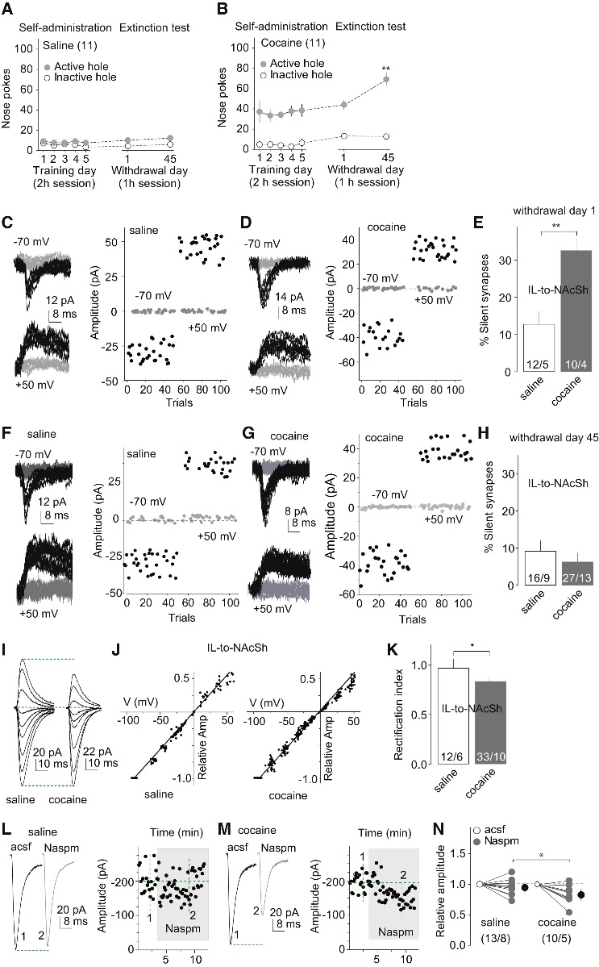
Ma et al., 2014: Figure 2
Generation and Maturation of Silent Synapses within the IL-to-NAcSh Projection after Cocaine Self-Administration
“Incubation of cocaine craving”
Notes:
(A and B) Summarized results show that after saline (A) or cocaine (B) self-administration (2 hr session) for 5 days after ∼12 hr overnight training cue-induced cocaine seeking (nose-pokes in the extinction test, 1 hr session) was significantly higher after 45 days of withdrawal from cocaine than after 1 day; nose-pokes remained low in all conditions in saline-exposed rats.

Slide 18
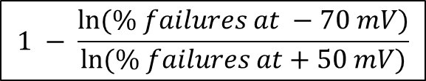
Ma et al., 2014: Figure 2 Continued
Generation and Maturation of Silent Synapses within the IL-to-NAcSh Projection after Cocaine Self-Administration
$$1 − \frac{ln⁡(\% failures at −70 mV)}{ln⁡(\% failures at+50 mV)}$$
Notes:
(C and D) EPSCs evoked at −70 or +50 mV by optogenetic minimal stimulation (left) over 100 trials (right) from an example recording of IL-to-NAcSh transmission 1 day after saline (C) or cocaine (D) self-administration.
(E) Summarized results showing that the level of silent synapses within the IL-to-NAcSh projection was significantly increased 1 day after cocaine self-administration (saline, 12.7% ± 3.5%, n/m = 12/5; cocaine, 32.5% ± 3.1%, n/m = 10/4; t23 = 4.2, p < 0.01, cell-based analysis, and t7 = 4.9, p < 0.01, animal-based analysis).
(F and G) EPSCs evoked at −70 or +50 mV by optogenetic minimal stimulation (left) over 100 trials (right) from an example recording of IL-to-NAcSh transmission 45 days after saline (F) or cocaine (G) self-administration.
(H) Summarized results showing that the level of silent synapses within the IL-to-NAcSh projection in cocaine-exposed rats returned to the basal level (saline) after 45 withdrawal days (saline, 9.1% ± 2.9%, n/m = 16/9; cocaine, 6.3% ± 2.4%, n/m = 27/13; t41 = 0.75, p = 0.46, cell-based; t20 = 1.3, p = 0.20, animal-based, t test).

Slide 19
Ma et al., 2014: Figure 2 Continued
Generation and Maturation of Silent Synapses within the IL-to-NAcSh Projection after Cocaine Self-Administration
Notes:
(I) Example EPSCs evoked from IL-to-NAcSh synapses at −70 to +70 mV (10–20 mV increments) from a saline- and a cocaine-exposed rat after 45 withdrawal days.
(J) The EPSC I-V curves from IL-to-NAcSh synapses in saline (left)-or cocaine (right)-exposed rats on withdrawal day 45.
(K) Summarized results showing that the rectification index of EPSCs from IL-to-NAcSh synapses was decreased (more rectifying) in cocaine-exposed rats on withdrawal day 45 (saline, 0.97 ± 0.09, n/m = 12/6; cocaine, 0.83 ± 0.01, n/m = 33/10; t43 = 2.30, p = 0.03, cell-based; t14 = 2.6, p = 0.02, animal-based, t test).
(L and M) Example EPSCs (left) and their time courses (right) from IL-to-NAcSh synapses in a saline-exposed (L) or cocaine-exposed (M) rat (on withdrawal day 45) before and during perfusion of Naspm.
(N) Summarized results showing that EPSCs from IL-to-NAcSh synapses were not affected by Naspm in saline-exposed rats, but were significantly inhibited by Naspm in cocaine-exposed rats (cell-based: saline/cocaine × acsf/Naspm, F1,21 = 5.0, p = 0.04, two-way ANOVA; p < 0.01, saline-Naspm versus cocaine-Naspm, Bonferroni posttest; animal-based: F1,11 = 6.2, p = 0.03). ∗p < 0.05; ∗∗p < 0.01.

Slide 20
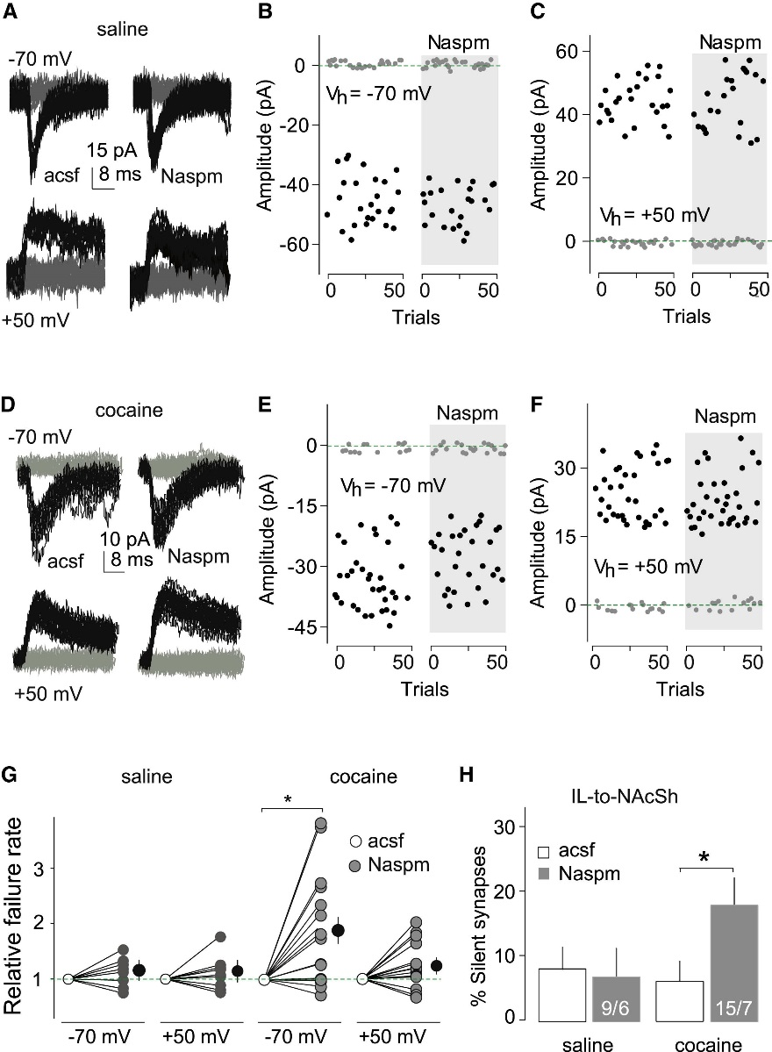
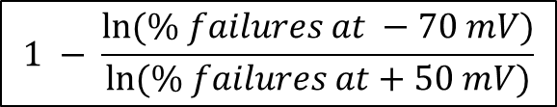
Ma et al., 2014: Figure 3
Inhibition of CP-AMPARs Causes Re-Emergence of Silent Synapses within the IL-to-NAcSh Projection after 45 days of Withdrawal from Cocaine
$$1 − \frac{ln⁡(\% failures at −70 mV)}{ln⁡(\% failures at+50 mV)}$$
Notes:
All experiments were performed using rats with intra-IL expression of ChR2 45 days after saline or cocaine self-administration.
(A) Example EPSCs evoked at −70 or +50 mV by optogenetic minimal stimulation of IL-to-NAcSh synapses in a saline-exposed rat before and during perfusion of Naspm.
(B and C) Consecutive trials of the example EPSCs in (A) at −70 (B) or +50 mV (C).
(D) Example EPSCs evoked at −70 or +50 mV by optogenetic minimal stimulation of IL-to-NAcSh synapses in a cocaine-exposed rat before and during perfusion of Naspm.
(E and F) Consecutive trials of the example EPSCs in (D) at −70 (E) or +50 mV (F).
(G) Summarized results showing that in saline-exposed rats the failure rate of IL-to-NAcSh synaptic transmission was not changed at either −70 or +50 mV by perfusion of Naspm (−70 mV/+50 mV × control-acsf/Naspm: F1,16 = 0.01, p = 0.9, cell based; F1,10 = 0.3, p = 0.60, animal based; two-way ANOVA). In cocaine-exposed rats, the failure rate was significantly increased by perfusion of Naspm at −70 mV, but not at +50 mV (cell based: −70 mV/+50 mV × control-acsf/Naspm, F1,28 = 5.3, p = 0.03; two-way ANOVA; p < 0.01, control-acsf versus Naspm at −70 mV, Bonferroni posttest; animal based: F1,12 = 7.9, p = 0.02).
(H) Summarized results showing that inhibiting CP-AMPARs by Naspm caused re-emergence of silent synapses within the IL-to-NAcSh projection 45 days after cocaine self-administration (cell based: saline-control, 9.4% ± 3.6%, saline-Naspm, 6.9% ± 4.5%, n/m = 9/6; cocaine-control, 6.4% ± 3.3%, cocaine-Naspm, 18.3% ± 4.3%, n/m = 15/7; saline/cocaine × control/Naspm, F1,22 = 4.3, p = 0.04, two-way ANOVA; p = 0.02, cocaine control versus cocaine-Naspm, Bonferroni posttest; animal-based: F1,11 = 9.5, p = 0.01). ∗p < 0.05.

Slide 21
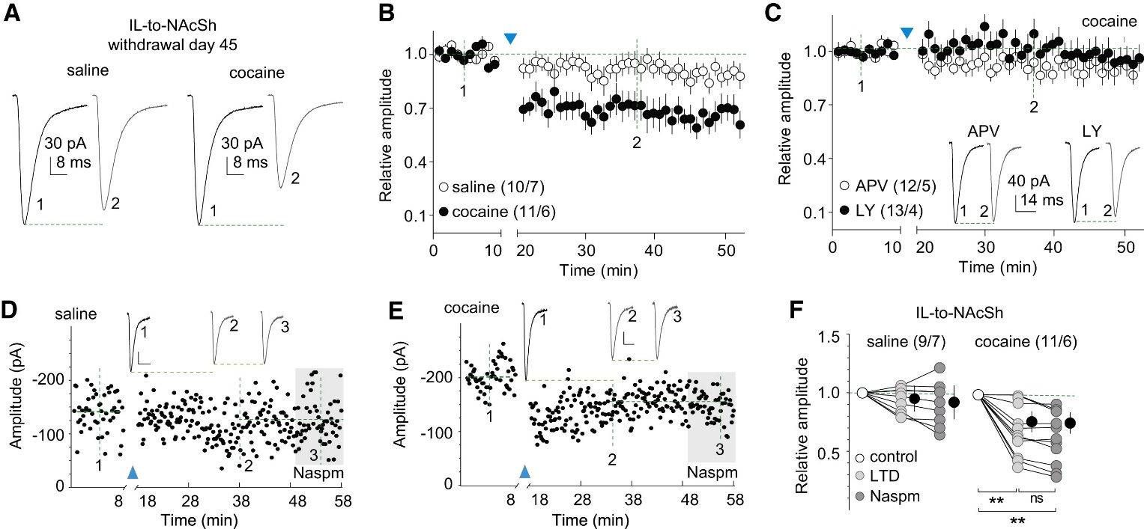
Ma et al., 2014: Figure 4
LTD Reverses Maturation of Silent Synapses within the IL-to-NAcSh Projection after 45 Days of Withdrawal from Cocaine
Notes:
All experiments were performed using rats with intra-IL expression of ChR2 45 days after saline or cocaine self-administration.
(A) Example EPSCs from IL-to-NAcSh synapses before and after LTD induction in saline- or cocaine-exposed rats.
(B) Summarized results showing that the LTD induction did not affect IL-to-NAcSh transmission significantly in saline-exposed rats but induced LTD in cocaine-exposed rats (cell based: saline/cocaine × LTD time course: F45,855 = 2.6, p < 0.01, two-way ANOVA; p = 1.00, saline-preLTD [at data point indicated by “1”] versus saline-postLTD [at data point indicated by “2”]; p < 0.01, cocaine-preLTD [at “1”] versus cocaine-postLTD [at “2”], Bonferroni posttest; animal based: F45,495 = 2.0, p < 0.01).
(C) Summarized results showing that LTD induction within the IL-to-NAcSh projection in cocaine-exposed rats was prevented in the presence of either APV or LY (APV/LY × LTD time course: F45,1035 = 1.0, p = 0.38, cell based; F45,315 = 1.2, p = 0.17, animal based). Insets show an example EPSCs before and after LTD induction.
(D) Time course of EPSCs of an example recording of IL-to-NAcSh synapses in a saline-exposed rat before and after LTD induction, and during perfusion of Naspm after LTD. Inset shows averaged EPSCs taken around the time points as specified. Calibration bars, 30 pA, 10 ms.
(E) Time course of EPSCs of an example recording of IL-to-NAcSh synapses in a cocaine-exposed rat before and after LTD induction, and during perfusion of Naspm after LTD. Inset shows averaged EPSCs taken around the time points as specified. Calibration bars, 20 pA, 10 ms.
(F) Summarized results showing that in saline-exposed rats IL-to-NAcSh transmission was not affected by LTD induction and subsequent perfusion of Naspm (F2,16 = 2.2, p = 0.15, cell based; F2,12 = 2.9, p = 0.09, animal based, one-way ANOVA); in cocaine-exposed rats this transmission, which would be inhibited by Naspm, was no longer sensitive to Naspm after LTD induction (cell based: F2,20 = 26.5, p < 0.01, one-way ANOVA; p < 0.01, preLTD versus postLTD; p < 0.01, preLTD versus postLTD-Naspm; p = 1.00, postLTD versus postLTD-Naspm, Bonferroni posttest; animal based: F2,10 = 18.2, p < 0.01). ∗∗p < 0.01; ns, not significant.

Slide 22
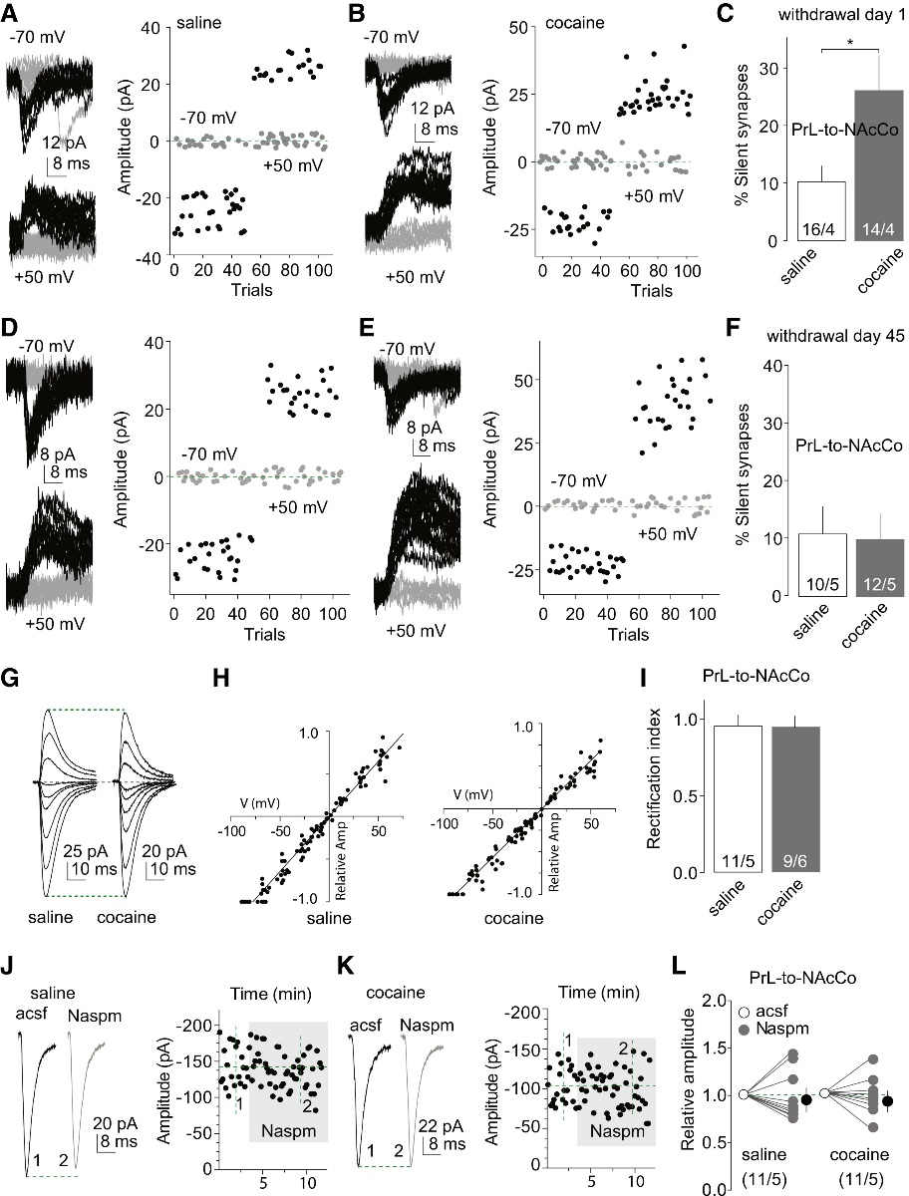
Ma et al., 2014: Figure 5
Generation and Maturation of Silent Synapses within the PrL-to-NAcCo Projection after Cocaine Self-Administration
$$1 − \frac{ln⁡(\% failures at −70 mV)}{ln⁡(\% failures at+50 mV)}$$
Notes:
(A and B) EPSCs evoked at −70 or +50 mV by optogenetic minimal stimulation (left) over 100 trials (right) from example recordings of PrL-to-NAcCo transmission in rats 1 day after saline (A) or cocaine (B) self-administration.
(C) Summarized results showing that percentage of silent synapses within the PrL-to-NAcCo projection was increased 1 day after cocaine self-administration (saline, 10.3% ± 2.8%, n/m = 16/4; cocaine, 26.2% ± 6.4%, n = 14/4; t28 = 2.4, p = 0.02, cell based; t6 = 2.5, p = 0.04, animal based, t test).
(D and E) EPSCs evoked at −70 or +50 mV by optogenetic minimal stimulations (left) over 100 trials (right) from example recordings of PrL-to-NAcCo transmission in saline-exposed (D) or cocaine-exposed (E) rats 45 days after self-administration.
(F) Summarized results showing that percentage of silent synapses within the PrL-to-NAcCo projection in cocaine-exposed rats returned to the basal level (saline) after 45 withdrawal days (saline, 11.0% ± 4.9%, n/m = 10/5; cocaine, 10.2% ± 4.6%, n/m = 12/5; t20 = 0.13, p = 0.9, cell based; t8 = 0.06, p = 0.95, animal based, t test).

Slide 23
Ma et al., 2014: Figure 5 Continued
Generation and Maturation of Silent Synapses within the PrL-to-NAcCo Projection after Cocaine Self-Administration
Notes:
(G) Example EPSCs evoked from PrL-to-NAcCo synapses at −70 to +70 mV (10–20 mV increments) from saline- and cocaine-exposed rats after 45 withdrawal days.
(H) The I–V curves of EPSCs evoked from PrL-to-NAcCo synapses in saline- or cocaine-exposed rats after 45 withdrawal days.
(I) Summarized results showing that rectification of AMPAR EPSCs from PrL-to-NAcCo synapses was not significantly altered in cocaine-exposed rats after 45 withdrawal days (saline, 0.96 ± 0.08, n/m = 11/5; cocaine, 0.96 ± 0.04, n/m = 9/6; t18 = 0.04, p = 0.97, cell based; t9 = 0.8, p = 0.5, animal based, t test).
(J and K) Example EPSCs (left) and their time courses (right) from PrL-to-NAcCo synapses in a saline-exposed (J) or cocaine-exposed (K) rat before and during perfusion of Naspm.
(L) Summarized results showing that EPSCs from PrL-to-NAcCo synapses were not affected by Naspm in saline- or cocaine-exposed rats (saline/cocaine × control/Naspm: F1,20 < 0.01, p = 0.98, cell based; F1,8 = 0.07, p = 0.79, animal based, two-way ANOVA). ∗p < 0.05.

Slide 24
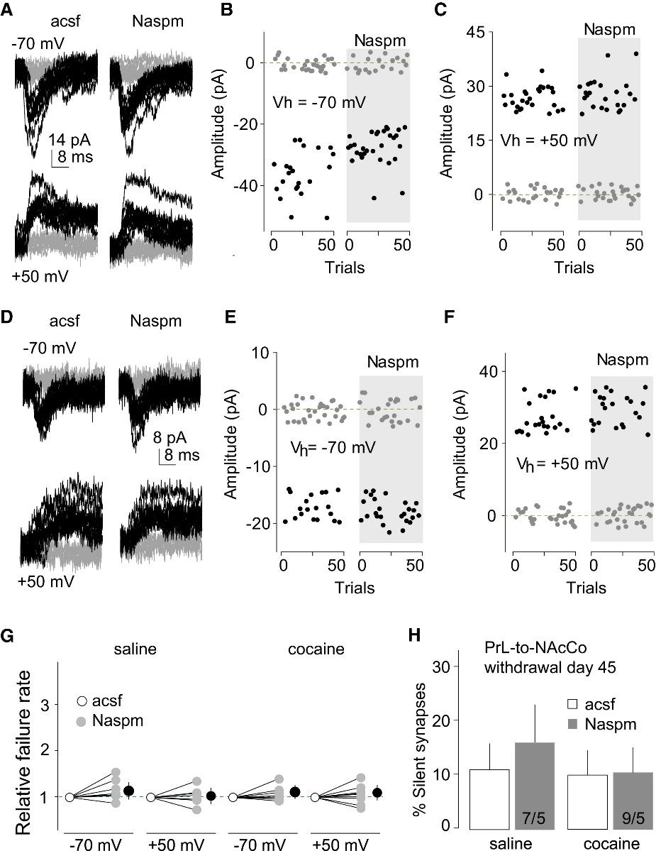
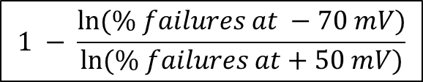
Ma et al., 2014: Figure 6
Inhibition of CP-AMPARs Does Not Cause Re-Emergence of Silent Synapses within the PrL-to-NAcCo Projection after 45 Days of Withdrawal from Cocaine
$$1 − \frac{ln⁡(\% failures at −70 mV)}{ln⁡(\% failures at+50 mV)}$$
Notes:
All experiments were performed using rats with PrL expression of ChR2 45 days after saline or cocaine self-administration.
(A) Example EPSCs evoked at −70 or +50 mV by optogenetic minimal stimulation of PrL-to-NAcCo synapses in a saline-exposed rat before and during perfusion of Naspm.
(B and C) Consecutive trials of the example EPSCs in (A) at −70 (B) or +50 mV (C).
(D) Example EPSCs evoked at −70 or +50 mV by optogenetic minimal stimulation of PrL-to-NAcCo synapses in a cocaine-exposed rat before and during perfusion of Naspm.
(E and F) Consecutive trials of the example EPSCs in (D) at −70 (E) or +50 mV (F).
(G) Summarized results showing that perfusion of Naspm did not affect the failure rates of PrL-to-NAcCo synaptic transmission at either −70 or +50 mV in saline-exposed (−70 mV/+50 mV × control-acsf/Naspm: F1,12 = 1.4, p = 0.25, cell based; F1,8 = 2.0, p = 0.20, animal based, two-way ANOVA) or cocaine-exposed (−70 mV/+50 mV × acsf/Naspm: F1,16 < 0.01, p = 0.94, cell based; F1,8 = 0.06, p = 0.81, animal based, two-way ANOVA) rats.
(H) Summarized results showing that inhibiting CP-AMPARs by Naspm did not cause re-emergence of silent synapses within the PrL-to-NAcCo projection 45 days after cocaine self-administration (percentage silent synapses: saline-control, 13.3 ± 6.6, saline-Naspm, 16.5 ± 7.8, n/m = 7/5; cocaine-control, 10.7 ± 5.8, cocaine-Naspm, 10.4 ± 4.6, n/m = 9/5; saline/cocaine × control/Naspm: F1,14 = 0.08, p = 0.80, cell based; F1,8 = 0.3, p = 0.61, animal based).

Slide 25
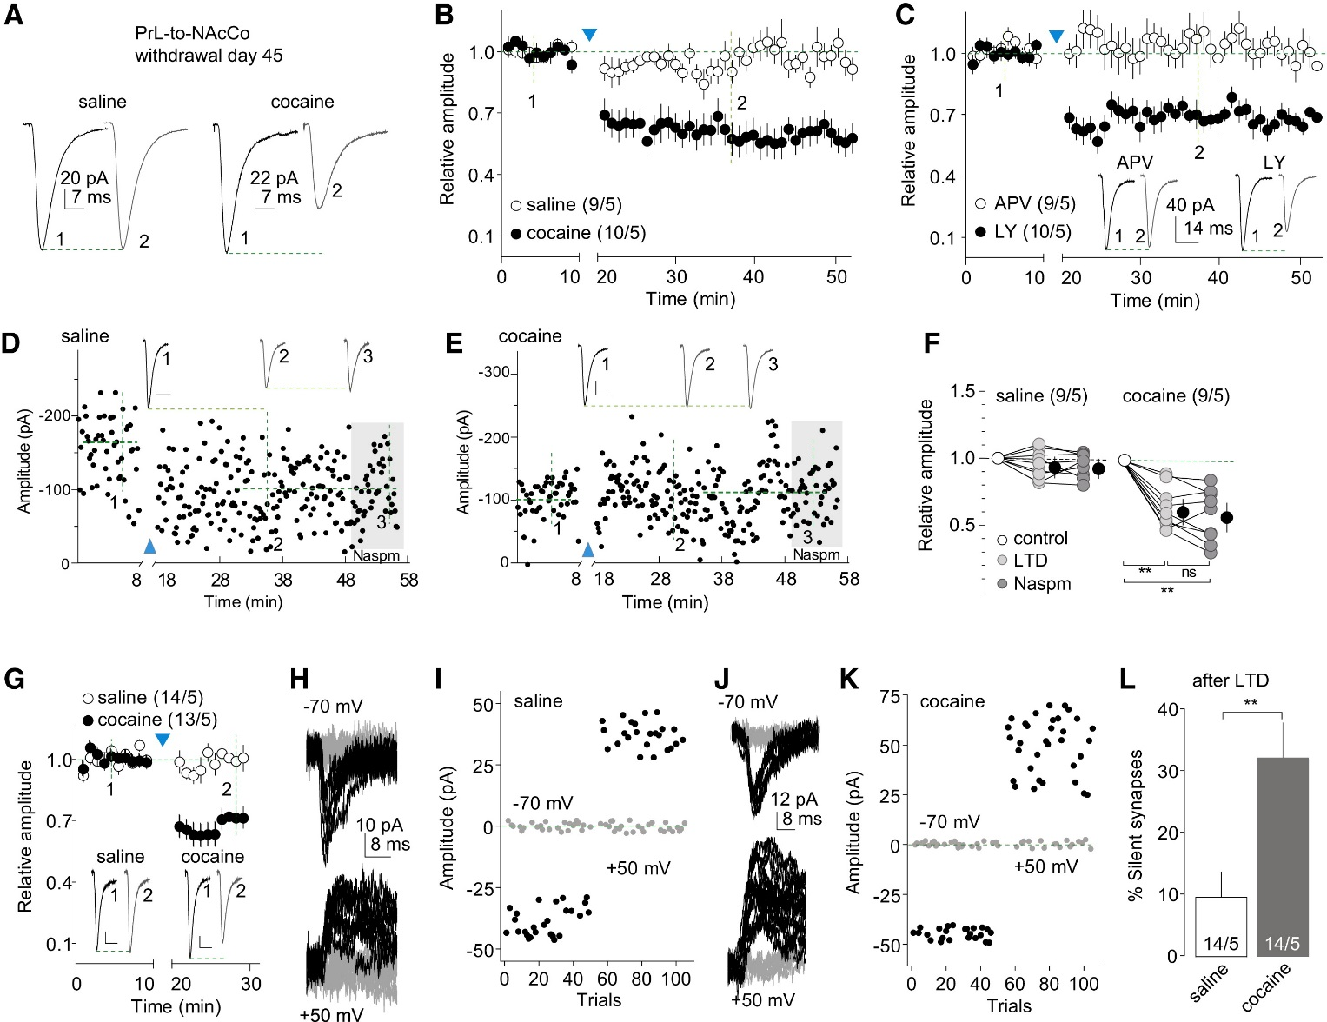
Ma et al., 2014: Figure 7
LTD Reverses Maturation of Silent Synapses within the PrL-to-NAcCo Projection after 45 Days of Withdrawal from Cocaine
Notes:
All experiments were performed using rats with intra-PrL expression of ChR2 45 days after saline or cocaine self-administration.
(A) Example EPSCs from PrL-to-NAcCo synapses before and after LTD induction in saline- or cocaine-exposed rats.
(B) Summarized results showing that the LTD induction did not affect PrL-to-NAcCo transmission in saline-exposed rats, but induced LTD in cocaine-exposed rats (saline/cocaine × pre/postLTD: F45,765 = 6.2, p < 0.01, two-way ANOVA; p = 0.99, saline-preLTD [at “1”] versus saline-postLTD [at “2”]; p < 0.01, cocaine-preLTD [at “1”] versus cocaine-postLTD [at “2”], Bonferroni posttest, cell based; F45,360 = 6.1, p < 0.01, animal based).
(C) Summarized results showing that LTD expression within the PrL-to-NAcCo projection in cocaine-exposed rats was prevented in the presence of APV but not LY (APV/LY × LTD time course: F45,765 = 4.4, p < 0.01, two-way ANOVA; p = 1.00, control versus APV at “2”; p = 0.01, control-LY versus LTD-LY at “2,” Bonferroni posttest, cell based; F45,360 = 4.0, p < 0.01, animal based). Insets show example EPSCs before and after LTD induction.
(D) Time course of EPSCs of an example recording of PrL-to-NAcCo synapses in a saline-exposed rat before and after LTD induction, and during perfusion of Naspm after LTD. Inset shows averaged EPSCs taken around the time points as specified. Calibration bars, 25 pA, 10 ms.
(E) Time course of EPSCs of an example recording of PrL-to-NAcCo synapses in a cocaine-exposed rat before and after LTD induction, and during perfusion of Naspm after LTD. Inset shows averaged EPSCs taken around the time points as specified. Calibration bars, 20 pA, 10 ms.
(F) Summarized results showing that EPSCs from PrL-to-NAcCo synapses were not affected by LTD protocol in saline-exposed rats (F2,16 = 1.7, p = 0.22, cell-based; F2,8 = 2.61, p = 0.13, animal-based; one-way ANOVA,) but were decreased in cocaine-exposed rats (F2,16 = 35.1, p < 0.01, one-way ANOVA; p < 0.01, preLTD versus either postLTD or postLTD-Naspm; p = 0.84, postLTD versus postLTD-Naspm, Bonferroni posttests, cell based; F2,8 = 31.87, p < 0.01, animal based), and perfusion of Naspm after LTD did not induce additional changes in EPSCs in either saline- or cocaine-exposed rats.

Slide 26
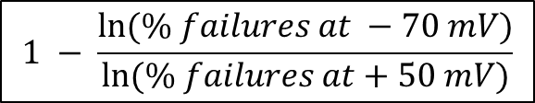
Ma et al., 2014: Figure 7 Continued
LTD Reverses Maturation of Silent Synapses within the PrL-to-NAcCo Projection after 45 Days of Withdrawal from Cocaine
$$1 − \frac{ln⁡(\% failures at −70 mV)}{ln⁡(\% failures at+50 mV)}$$
Notes:
All experiments were performed using rats with intra-PrL expression of ChR2 45 days after saline or cocaine self-administration.
(G) Summarized results showing the LTD induction of two sets of NAcCo MSNs (from saline- or cocaine-exposed rats) that were subsequently assessed for percentage of silent synapse analysis in (H)–(L). Inset shows EPSCs from PrL-to-NAcCo synapses before and after LTD induction in saline- or cocaine-exposed rats (saline/cocaine × LTD time course: F19,475 = 9.3, p < 0.01, cell based; F(19,152) = 5.9, p < 0.01, animal based; two-way ANOVA). Calibration bars, 30 pA, 10 ms.
(H and I) EPSCs evoked at −70 or +50 mV by optogenetic minimal stimulations (H) over 100 trials (I) in an example recording of PrL-to-NAcCo synapses after LTD induction of these synapses in a saline-exposed rat.
(J and K) EPSCs evoked at −70 or +50 mV by optogenetic minimal stimulations (J) over 100 trials (K) in an example recording of PrL-to-NAcCo synapses after LTD induction of these synapses in a cocaine-exposed rat.
(L) Summarized results showing that LTD induction induced reemergence of silent synapses in the PrL-to-NAcCo projection of rats 45 days after cocaine self-administration (percentage of silent synapses: saline, 9.8 ± 4.2, n/m = 14/5; cocaine, 32.4 ± 6.2, n/m = 14/5, t26 = 3.04, p < 0.01, t test, cell based; t8 = 2.5, p = 0.04, animal based). ∗∗p < 0.01; ns, not significant.

Slide 27
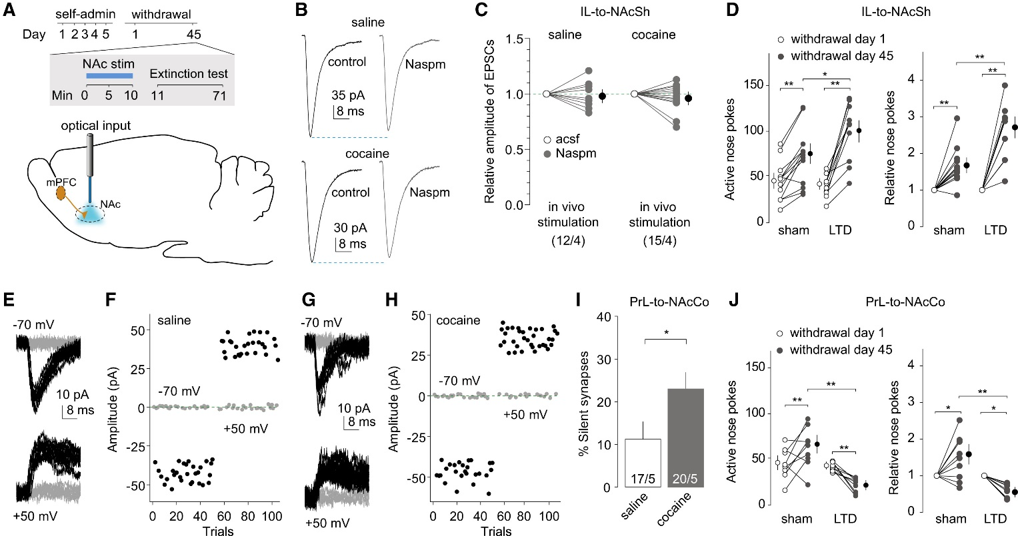
Ma et al., 2014: Figure 8
Reversing the Maturation of Silent Synapses in the IL-to-NAcSh and PrL-to-NAcCo Projections Causes Opposing Effects on Incubation of Cocaine Craving
Notes:
(A) Diagrams showing the timeline of behavioral experiments and the LTD induction in both PFC-to-NAc projections before the test for cue-induced cocaine seeking on withdrawal day 45.
(B) Example EPSCs from IL-to-NAcSh synapses before and during perfusion of Naspm in a NAc slice from a rat receiving intra-NAcSh LTD induction 45 days after saline (upper) or cocaine self-administration (lower).
(C) Summarized results showing that in cocaine-exposed rats EPSCs at IL-to-NAcSh synapses were no longer inhibited by Naspm after in vivo LTD induction (saline/cocaine × withdrawal day: F1,25 = 0.16, p = 0.69, cell based; F1,6 = 0.00, p = 0.95, animal based; two-way ANOVA).
(D) LTD induction in the IL-to-NAcSh projection increased incubated cue-induced cocaine seeking in the extinction test. Data are presented as the numbers of nose-pokes to active holes on withdrawal days 1 and 45 (left) (withdrawal day × sham/LTD: F1,22 = 13.4, p < 0.01, two-way ANOVA; p < 0.01, sham-withdrawal day 1 versus sham-withdrawal day 45; p = 0.01, sham-withdrawal day 45 versus LTD-withdrawal day 45, Bonferroni posttest) and the nose-pokes on withdrawal day 45 relative to withdrawal day 1 (right) (withdrawal day × sham/LTD: F1,22 = 13.1, p < 0.01, two-way ANOVA; p < 0.01, sham-withdrawal day 1 versus sham-withdrawal day 45; p < 0.01, sham-withdrawal day 45 versus LTD-withdrawal day 45, Bonferroni posttest).

Slide 28
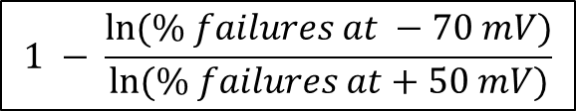
Ma et al., 2014: Figure 8
Reversing the Maturation of Silent Synapses in the IL-to-NAcSh and PrL-to-NAcCo Projections Causes Opposing Effects on Incubation of Cocaine Craving
$$1 − \frac{ln⁡(\% failures at −70 mV)}{ln⁡(\% failures at+50 mV)}$$
Notes:
(A) Diagrams showing the timeline of behavioral experiments and the LTD induction in both PFC-to-NAc projections before the test for cue-induced cocaine seeking on withdrawal day 45.
(E–H) Example EPSCs and their time courses in the minimal stimulation assay of PrL-to-NAcCo projection in a NAc slice from a rat receiving intra-NAcCo LTD induction 45 days after saline (E and F) or cocaine (G and H) self-administration.
(I) Summarized results showing that after in vivo LTD induction in the PrL-to-NAcCo projection, percentage of silent synapses was increased 45 days after cocaine self-administration (saline, 11.2% ± 4.3%, n/m = 17/5; cocaine, 23.2% ± 4.9%, n/m = 20/5, t35 = 2.0, p = 0.048, cell based; t8 = 3.3, p = 0.01, anima based; t test).
(J) LTD induction in the PrL-to-NAcCo projection decreased incubated cue-induced cocaine seeking in the extinction test. Data are presented as the numbers of nose-pokes to active holes on withdrawal days 1 and 45 (left) (withdrawal day × sham/LTD: F1,16 = 17.8, p < 0.01, two-way ANOVA; p < 0.01, sham-withdrawal day 1 versus sham-withdrawal day 45; p < 0.01, LTD-withdrawal day 1 versus LTD-withdrawal day 45; p < 0.01, sham-withdrawal day 45 versus LTD-withdrawal day 45, Bonferroni posttest) and changes (relative) of nose-pokes between the two withdrawal days (right) (withdrawal day × sham/LTD: F1,16 = 16.9, p < 0.01, two-way ANOVA; p = 0.03, sham-withdrawal day 1 versus sham-withdrawal day 45; p = 0.02, LTD-withdrawal day 1 versus LTD-withdrawal day 45; p < 0.01, sham-withdrawal day 45 versus LTD-withdrawal day 45, Bonferroni posttest). ∗p < 0.05; ∗∗p < 0.01.

Slide 29
Ma et al., 2014: Summary

Slide 30
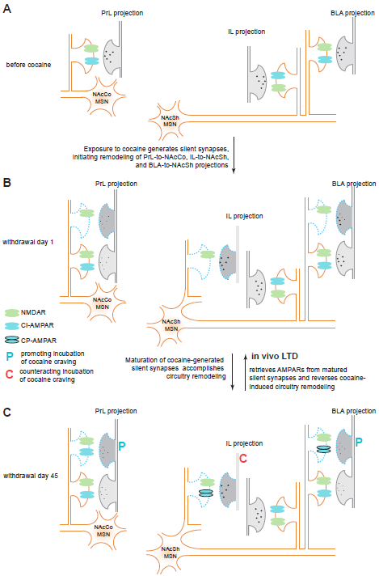
Ma et al., 2014: Supplemental Figure 4

